Slide 1
A Voice Controlled Streaming Jukebox
based on IBM Bluemix Cloud Service

Slide 2
Introduction
An IoT production
Based on IBM Bluemix cloud service.
Use Mopidy to stream Spotify music.
Implement the Jukebox on Raspberry Pi.

Slide 3
Features
Sound-driven
Remote-controlled
Bi-directional connection
Lightweight

Slide 4

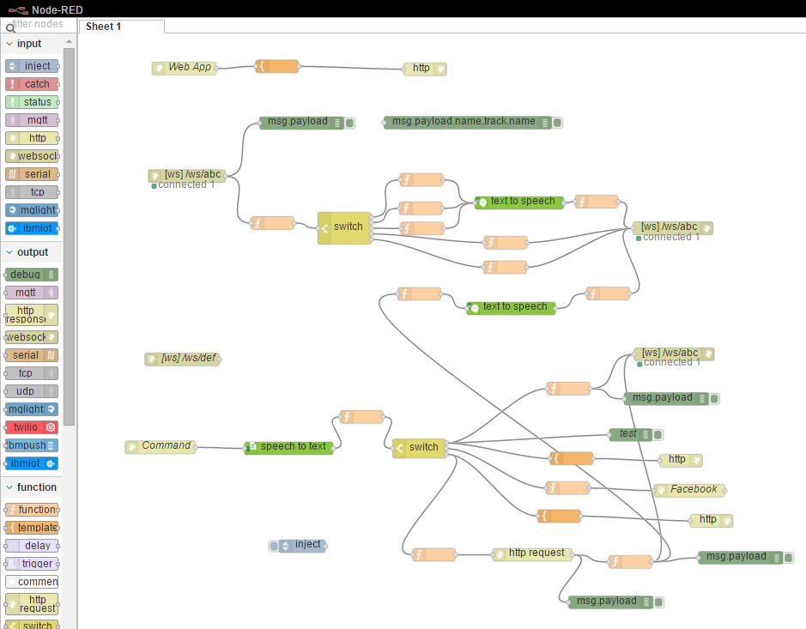
IBM Bluemix
PaaS developed by IBM
Speech to Text
Node RED

Slide 5

Mopidy
An extensible music server
Streaming music from the cloud
https://nctu.me/mopify/

Slide 6

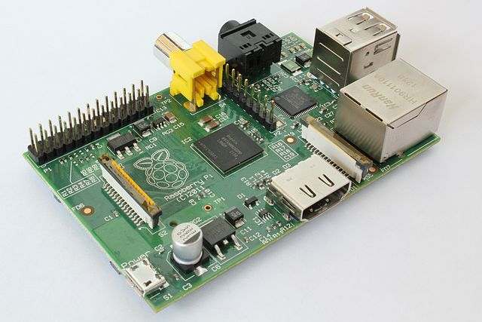
Mopidy on Raspberry Pi
+

Slide 7
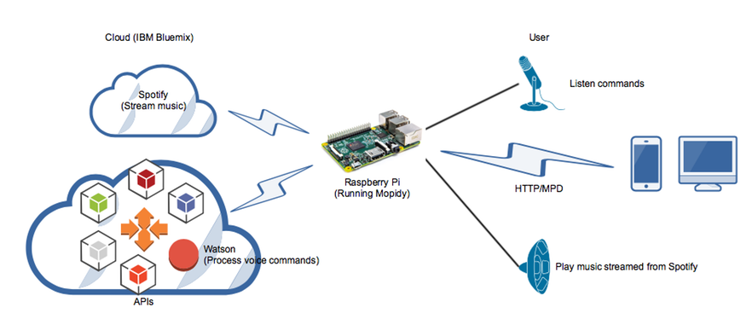
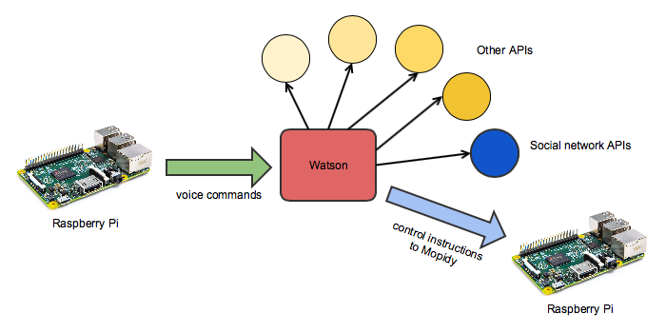

Proposed Model

Slide 8
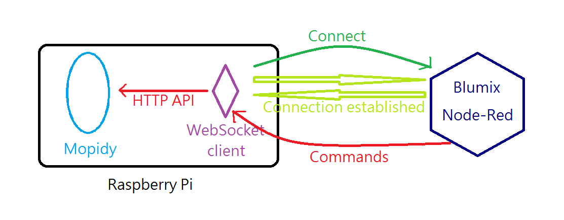
Connection

Slide 9


UP
PAUSE
DOWN
PLAY

Slide 10
Command
Play/Pause/Again
Next/Previous
Shut up/Wake up
What is the song?/What’s next?
Who are you?
Play XXX

Slide 11
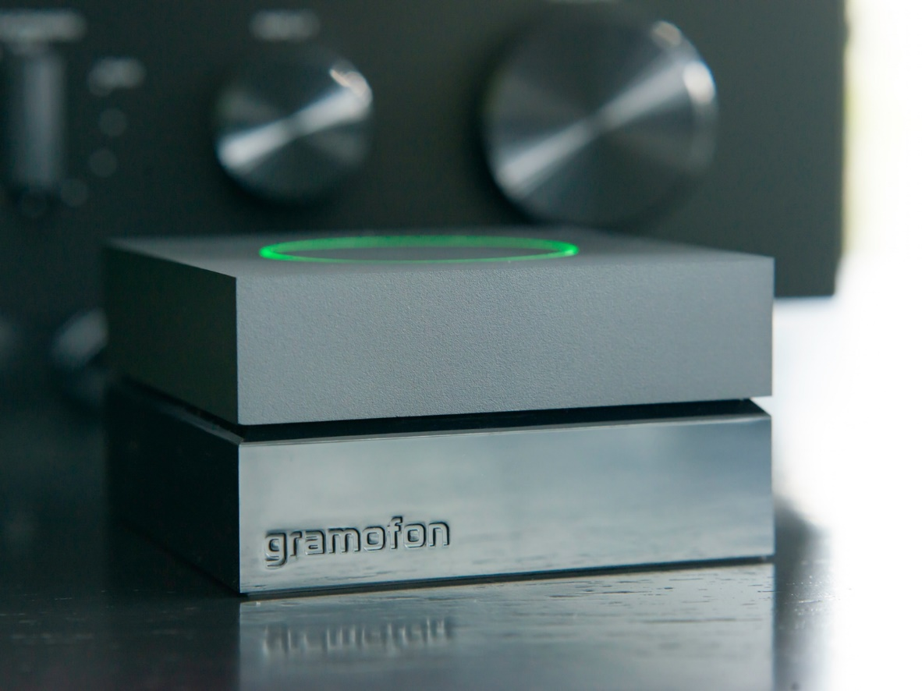
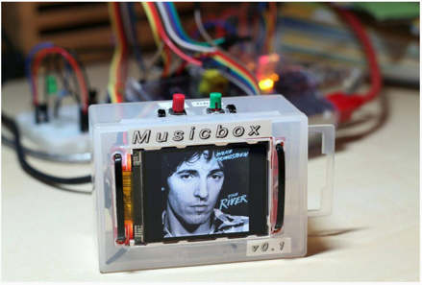
Related Work
Gramofon
Pi MusicBox

Slide 12

Post it on Facebook!
Exclamation
Link
Hashtag

Slide 13





Recommendation

Slide 14
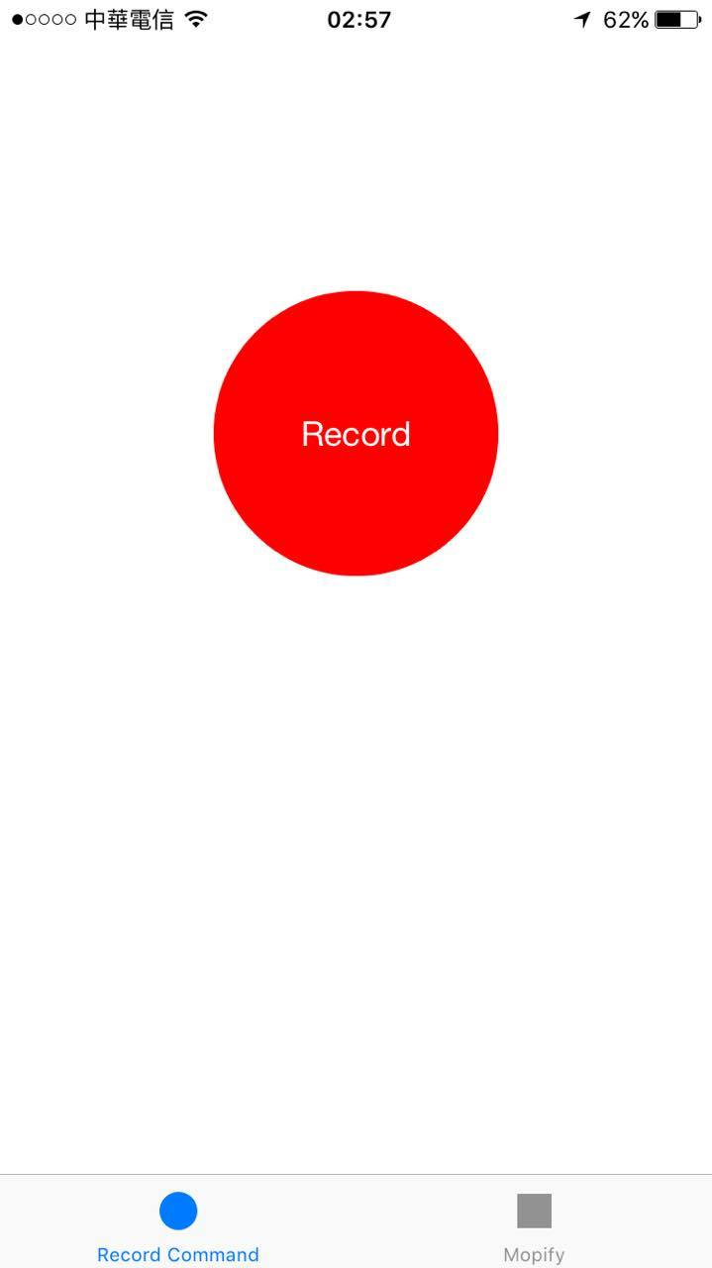
Features
Sound-driven
Bi-directional connection
Lightweight
Remote-controlled
https://nctu.me/recorder
APP

Slide 15
Skills & Techniques
Node-RED layout design
API calls
Node JS
Natural language processing

Slide 16

Future Work
More Artificial Intelligence
Linguistic Analysis
Correspondent discoveries
More Integration
Music recognition
Lyrics synchronization

